Slide 1
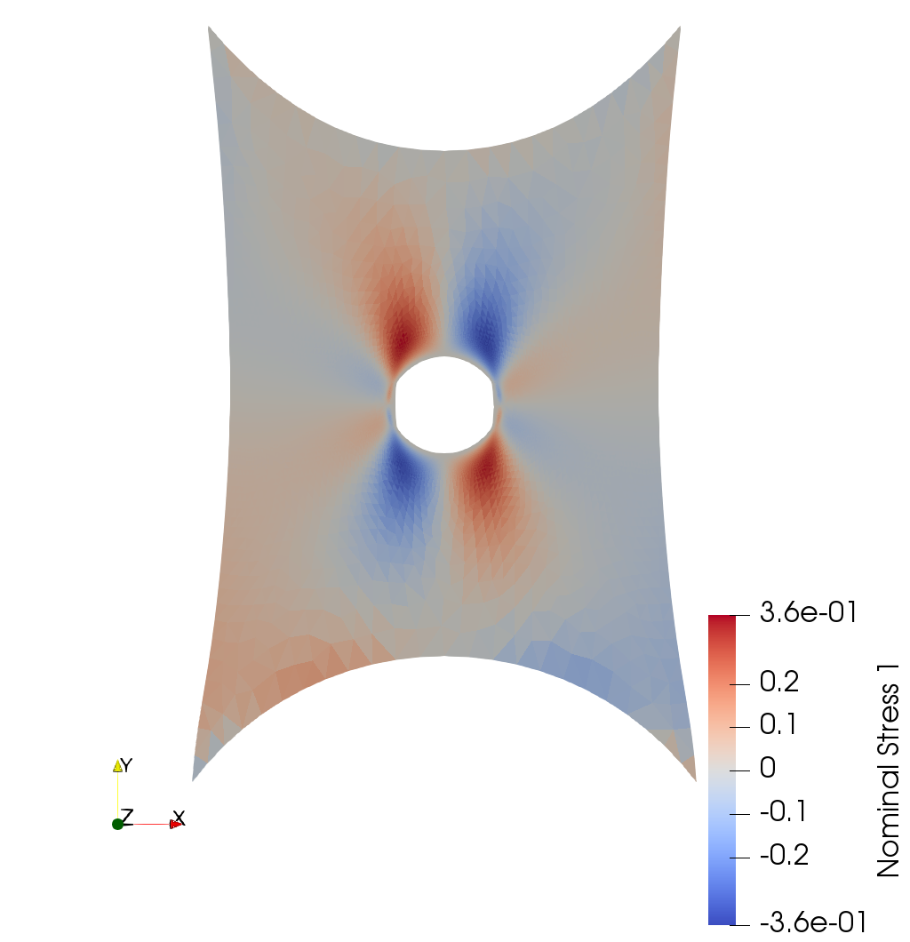
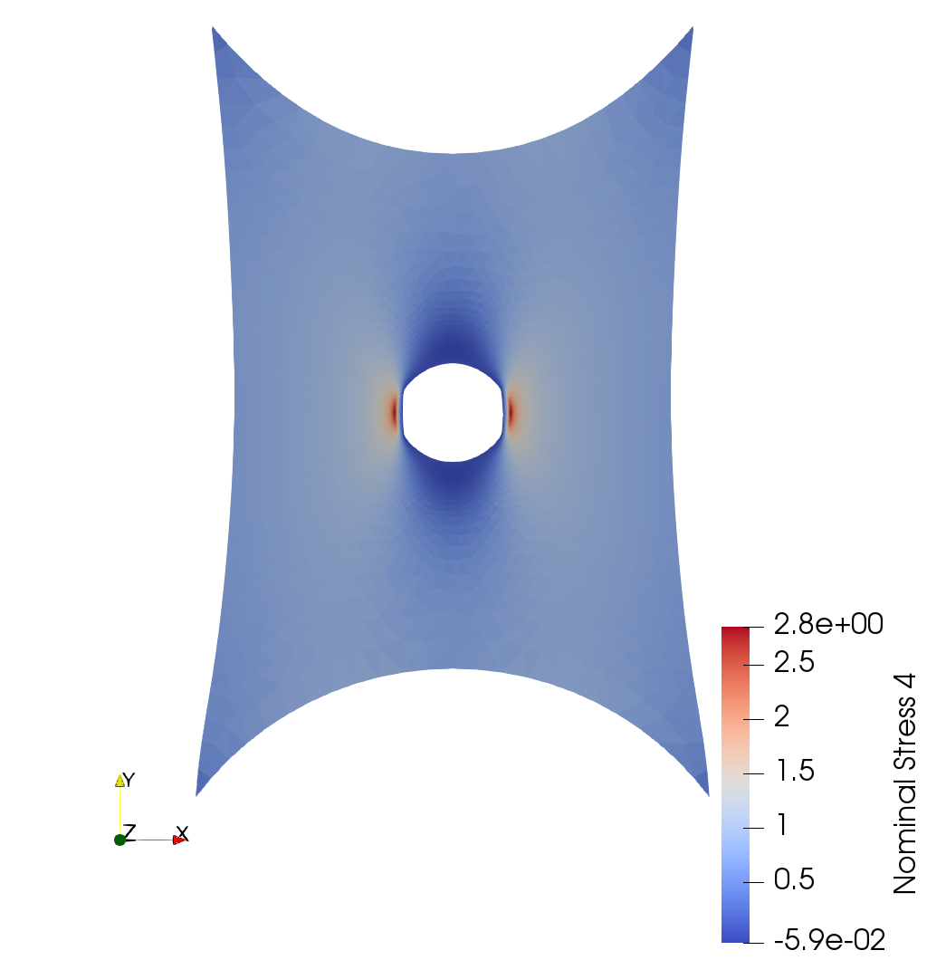
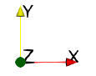
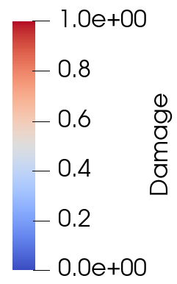
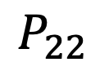

$$P_{12}$$
$$P_{22}$$
a)
b)
1
2
3
4
5
Notes:
Figure 5: Original

Slide 2
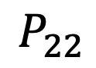

$$P_{12}$$
$$P_{22}$$
a)
b)
Ⅰ
Ⅱ
Ⅲ
Ⅳ
Ⅴ
Notes:
Figure 5: Option1

Slide 3
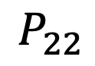

$$P_{12}$$
$$P_{22}$$
a)
b)
1
2
3
4
5
Notes:
Figure 5: Option2

Slide 4
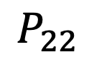

$$P_{12}$$
$$P_{22}$$
a)
b)
1
2
3
4
5
Notes:
Figure 5: Option3

